Slide 1
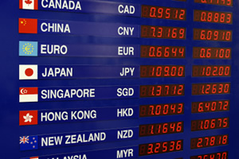
CISI – Financial Products, Markets & Services
Topic – Financial Assets and Markets
(3.4) The Foreign Exchange Market

Slide 2
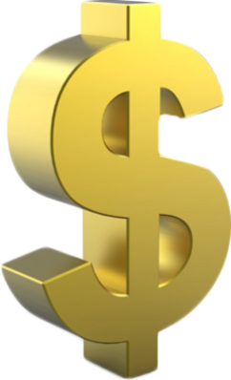
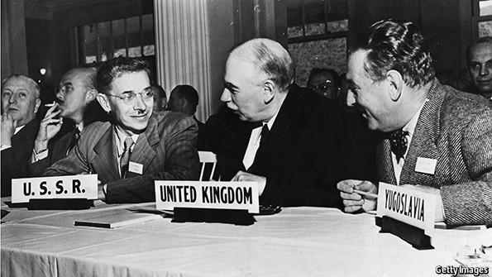
The Bretton Woods Agreement
An agreement reached in July 1944 between 44 countries to restructure the international financial system, post-war World War II.
Date | GBP : USD
27 December 1945 | £1.00 : US$4.03
18 September 1949 | £1.00 : US$2.80
17 November 1967 | £1.00 : US$2.40
The US Dollar become the world’s central currency, linked to the value of gold. The exchange rates of most major currencies were fixed against the US dollar.
The agreement prevented countries from devaluing their currencies to seek an unfair trade advantage.
World trade among developed countries grew rapidly in the 1950s and 1960s, boosting world output and raising the standard of living, especially in Europe and Japan.

Slide 3
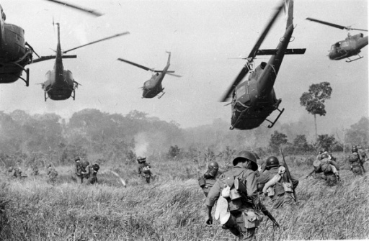
The demise of Bretton Woods
By the 1970s, the cost of the Vietnam War and the running of trade deficits put the US Dollar under pressure.
This led to a steady flow of US dollars (and therefore gold) out of the US. By 1971, the US only had reserves of gold sufficient to cover 22% of the US dollars in issue.
It has been estimated that the true market price of gold in 1971 should have been US$103 per ounce.
Before the collapse of Bretton Woods, the French central bank was buying US dollars with French francs, and converting the US dollars into gold at US$35 per ounce.
15th August 1971, President Nixon announces the end of the gold standard for the US dollar
Nixon ends gold standard

Slide 4
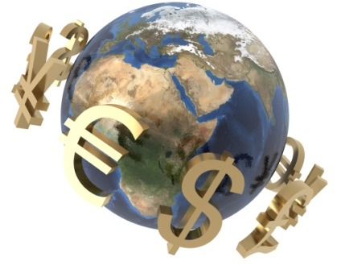
Introducing the Foreign Exchange Market
The foreign exchange market refers to the trading of one currency for another.
It is by far the busiest and most active of the financial markets, with turnover comfortably exceeding that of bonds and equities.
It is also known as:
The forex market
The FX market
Source: http://www.xe.com
Most currencies are allowed by their
central banks to “float” - exchange rates
between one currency and another can
vary.
The value of one currency versus another
will depend on the economic health of
the issuer
This creates risks for companies operating
internationally
Interest rates and the balance of payments are key determinants

Slide 5
Floating Exchange Rates
With the end of the Bretton Woods system, most of the major currencies float against each other in value.
Date | GBP : USD
27th December 1945 | £1.00 : US$4.03
18th September 1949 | £1.00 : US$2.80
17th November 1967 | £1.00 : US$2.40
17th November 1977 | £1.00 : US$1.82
17th November 1987 | £1.00 : US$1.76
17th November 1997 | £1.00 : US$1.69
17th November 2007 | £1.00 : US$2.05
17th November 2008 | £1.00 : US$1.50
17th November 2009 | £1.00 : US$1.68
17th November 2010 | £1.00 : US$1.59
17th November 2011 | £1.00 : US$1.58
17th November 2012 | £1.00 : US$1.59
17th November 2013 | £1.00 : US$1.61
17th November 2014 | £1.00 : US$1.56
Some currencies are still fixed (or “pegged”) against another major currency:
Jordan, Bahrain, Lebanon, Oman, Qatar, Saudi Arabia, UAE, Hong Kong all peg their currencies to the US dollar
Morocco, Senegal, Ivory Coast, Cameroon, New Caledonia, all peg their currencies to the euro
Until 2005, China pegged the yuan to the US dollar, but now allows it to fluctuate within a narrow band
Source: Bank of England

Slide 6
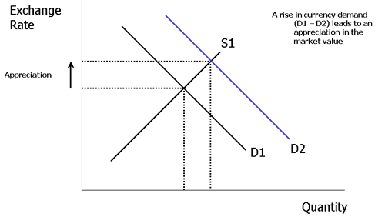
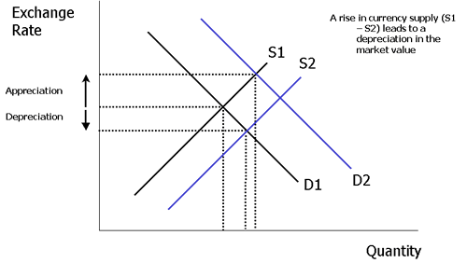
Floating Exchange Rates
Changes in market demand and market supply of a currency cause a change in value.
A rise in the demand for sterling (perhaps caused by a rise in exports or an increase in the speculative demand for sterling) leads to an appreciation in the value of the pound.
Changes in currency supply also have an effect. In the diagram above there is an increase in currency supply (S1-S2) which puts downward pressure on the market value of the exchange rate.

Slide 7
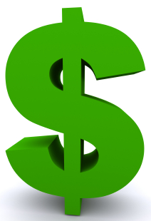
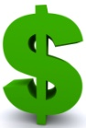
Currency Quotes
Trading of foreign currencies clearly involves selling one currency and buying another, the two currencies involved are described as ‘pairs’.
Price at which a pair is bought and sold is the exchange rate
Base Currency
The first currency quoted in a pair
It is always equal to one unit of that currency
Counter or Quote Currency
The second currency quoted in a pair
1 : 0.75
In this case $1 is worth £0.75
GBP
USD
When the exchange rate is being quoted, the name of the each currency is abbreviated to a three letter reference
Most commonly quoted currency pairs:
USD
JPY
Eur
USD
USD
CHF
GBP
USD
Eur
GBP

Slide 8
Currency Quotes
When currency pairs are quoted, the foreign exchange trader will quote a bid and ask price:
Quote
1.1164/66
USD
GBP
When quoting, the base currency is not mentioned as the convention is that the base currency is always 1
In this case:
If a client wants to buy £100,000 he will need to pay the higher of the two prices ($1.1166) and deliver $111,660
If a client wants to sell £100,000 he will need to pay the lower of the two prices ($1.1164) and receives $111,640

Slide 9
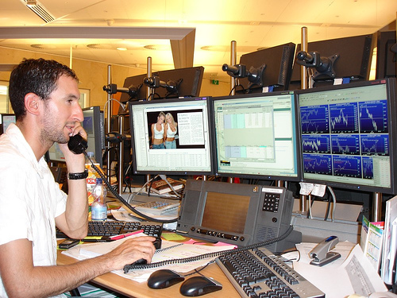
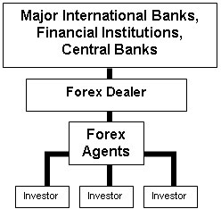
Currency Trading
The forex market is primarily an over-the-counter (OTC) market, where brokers and dealers negotiate directly with each other.
London has grown to become the world’s largest forex market due to it’s ideal location between the Asian and American time zones
Continually provide the market with both bid (buy) and ask (sell) prices
Use the market to try to control money supply, inflation and interest rates.
Individual forex traders (i.e. retail investors) are becoming increasingly important in the global forex market.

Slide 10
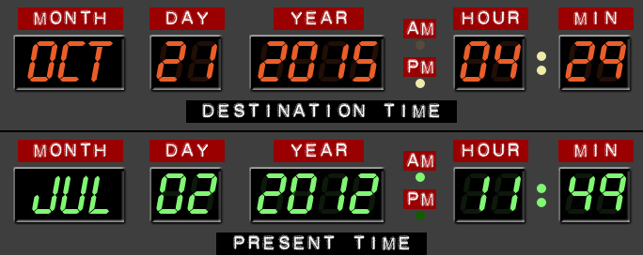
Types of FX transactions and financial instruments
There are several types of transactions and financial instruments commonly used:
1. Spot transaction
The ‘spot rate’ is the rate quoted by a bank for the exchange of one currency for another with immediate effect.
Trades are technically ‘settled’ (currencies actually change hands and arrive in recipients’ bank accounts) two business days after the transaction date (T+2).
2. Forward transaction
Money does not actually change hands until some agreed future date.
A buyer and seller agree on an exchange rate for any date in the future, for a fixed sum of money, and the transaction occurs on that date, regardless of what the market rates are then.
The duration of the trade can be a few days, months or years.

